Slide 1

Task 2
Predicting customer buying behaviour

Slide 2
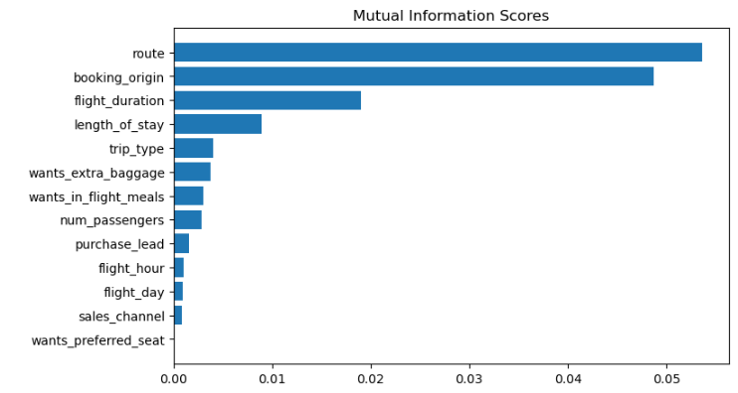
Top 5 factors that influence buying behaviour
ROUTE
BOOKING ORIGIN
FLIGHT DURATION
LENGH OF STAY
TRIP TYPE
Accuracy Score Using Random Forest Classifier Model
ACCURACY: 85.11
AUC score: 0.558

